Slide 1
Human-Machine Teaming Hackathon Challenge
Glen Smith, Qiao Zhang | Georgia Institute of Technology
Notes:
Dice adventure
Reinforcement learning model (PPO)
State representation and training interface
Video comparison?
HTN model
State representation

Slide 2
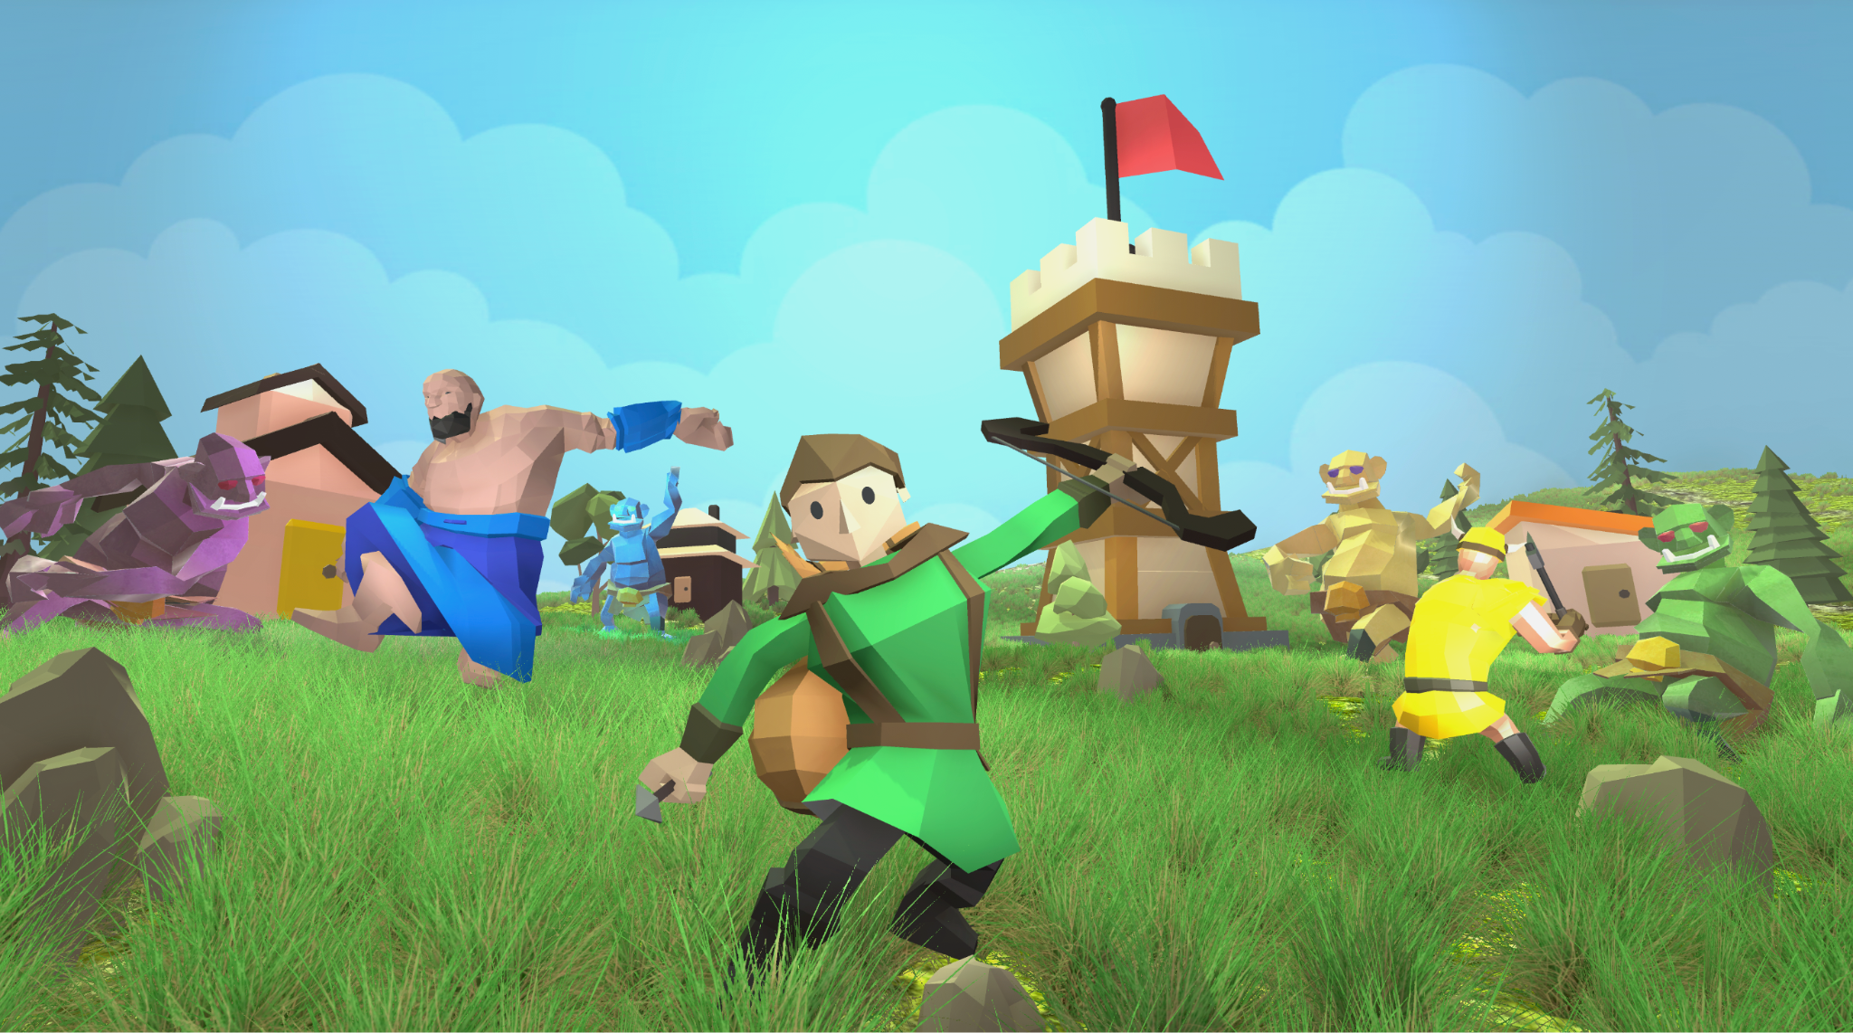
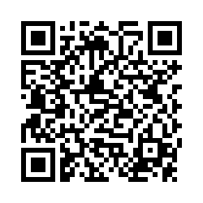
Hackathon Information
Theme: Human-AI Teaming
Audience: anyone who is interested in developing AI agents and/or playing games
Date: 6/24 - 6/25/2024
Environment: Dice Adventure
Location: Georgia Institute of Technology, Atlanta, GA
Please fill out the interest form for upcoming updates and information!
https://strong-tact.github.io/strong_hackathon/
Notes:
Audience, welcome participants with technical or non-technical

Slide 3
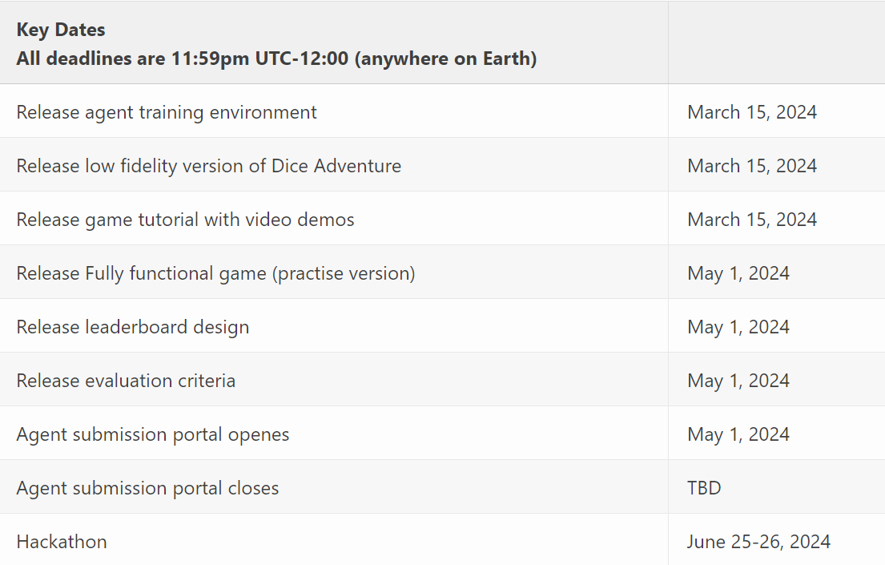
Tentative Schedule
Notes:
Present this slide if audience ask for schedule.

Slide 4
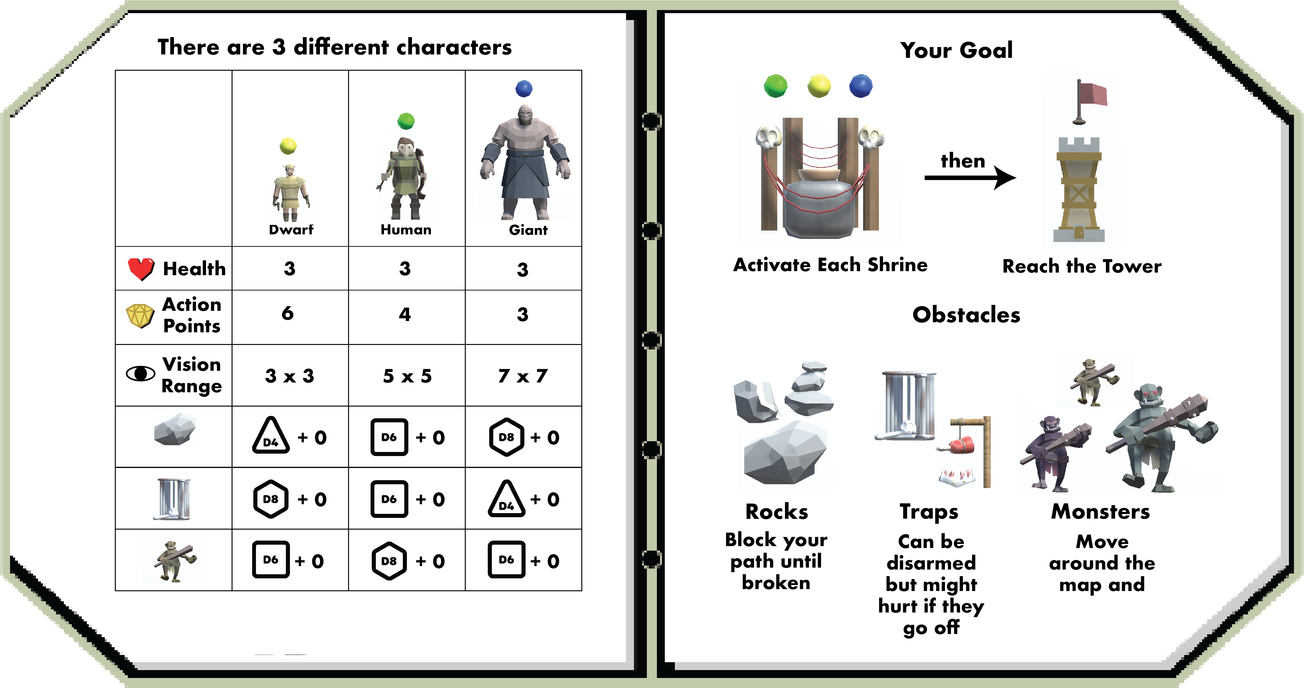
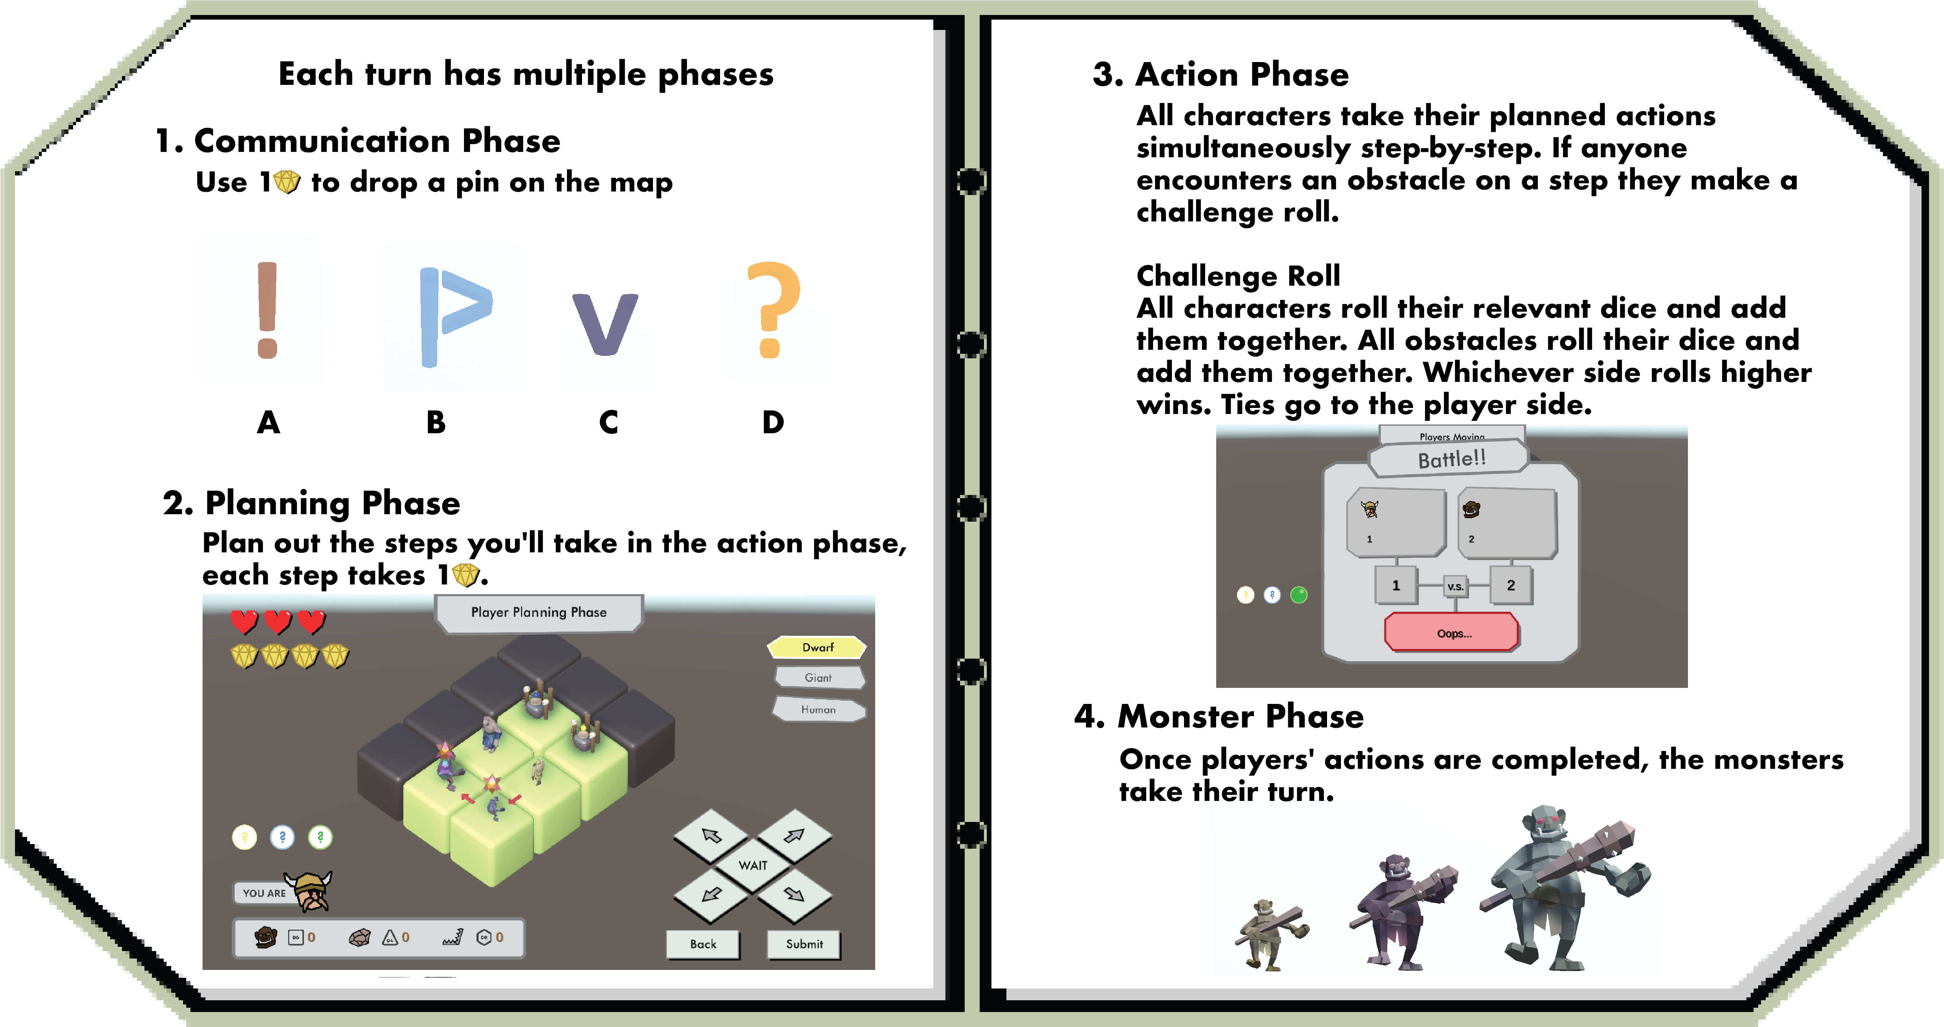
Dice Adventure
Multiplayer, turn-based, dungeon crawling game
Asymmetric information, stochastic processes
Navigate through the maze and overcome obstacles
Please join us at Demo Session 2 for more details and to play the game!
Notes:
Game developed at CMU
Three characters, different view and capabilities
Use the arrow keys to navigate through the maze, overcome obstacles
Join as at Demo tomorrow

Slide 5
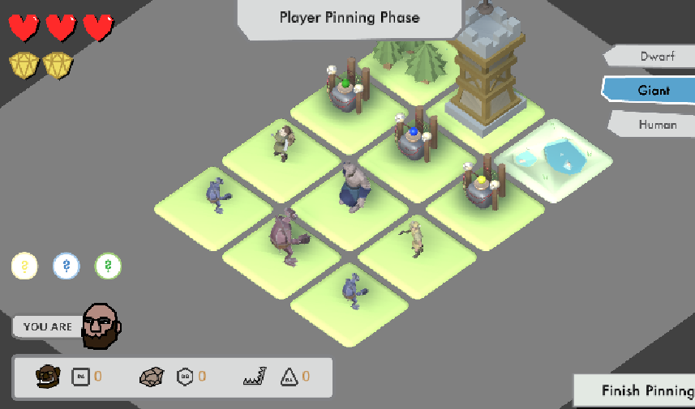
Dice Adventure – Key Teaming Elements
Each character has unique capabilities
Subgoals (shrine) need to be reached before a team goal (tower) is reached to clear the level
All communication is denied except for the ability to place pings on map
Teammates must interpret ping usage by others
Notes:
Players work together with unique abilities to form a team.
There are subgoals...
Verbal and textual is denied in the game. Instead use pinning system
Players

Slide 6
Motivation and Research Questions
Motivation
Understanding the unique roles that humans and AI agents play in a collaborative task
Exploring the benefit and effect of hybrid, human-AI teams
RQ1: How can different team allocations affect the team’s performance?
RQ2: How will role assignment affect the team’s performance?
RQ3: How can team communication dynamics affect the team’s performance?
Notes:
Team allocation: two human one AI, two AI one human
Role assignment: players can select characters and decide which character the AI can play
Team communication: collect game play data to log all interactions, understand how teammates are communicating with each other

Slide 7
Hackathon Logistics
Two tracks
Agent development track
We will provide starter code and 2D game environment (in Python) for agent training.
Participants in this track will develop agents that can play with human players.
Player track
Players can select any agent(s) they want to play with.
Players can play multiple games with different teammates.
Two allocations: (1) one player two AI agents, (2) two players one AI agent
Evaluation criteria
We will use in-game statistics to calculate a weighted score to decide the winner.
Teams will be evaluated separately based on the allocations.
Prizes will be provided!
Notes:
Welcome everyone that is interested to join.
People with technical background can develop and submit agent.
General audience can participate by play the game with submitted agents.
We will provide baseline agents for people to play with.

Slide 8
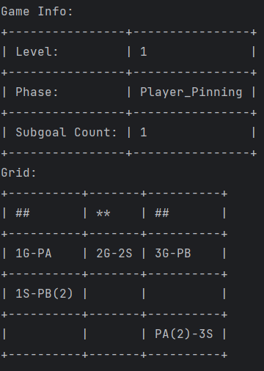
Agent Training Interface
Python version of Dice Adventure to train agents
Simple ‘gymnasium’ environment interface
Can train many kinds of models including offline and online

Slide 9
Agent Submission
We will open the submission portal on 5/1/24
Exact submission format will be communicated in advance
We encourage submission of online and offline agents

Slide 10
Example Models

Slide 11
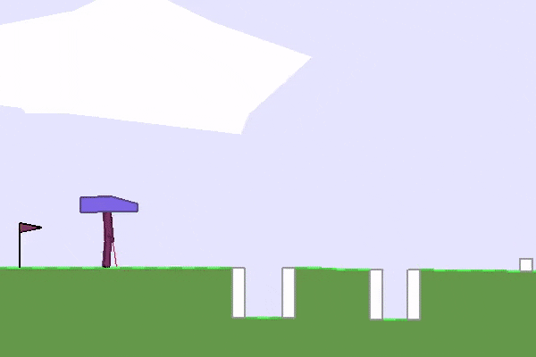
PPO Model (Proximal Policy Optimization) - Offline
State-of-the-art class of reinforcement learning models developed by OpenAI, creator of ChatGPT
Learns complex tasks with less hyperparameter tuning than similar models and achieves comparable performance
Great for high-dimensional environments (such as Dice adventure)
https://medium.com/@ngoodger_7766/proximal-policy-optimisation-in-pytorch-with-recurrent-models-edefb8a72180
https://openai.com/research/openai-baselines-ppo

Slide 12
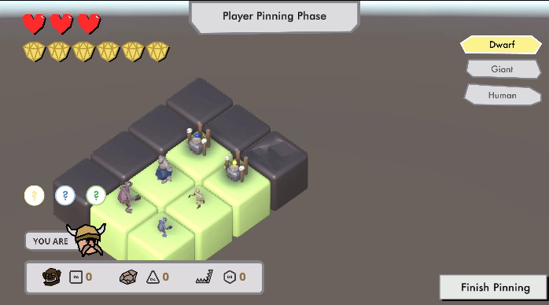
Notes:
Little over 1000 dimensional vector

Slide 13
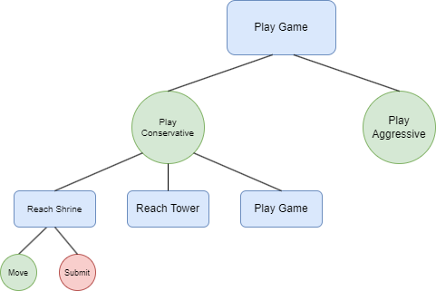
Hierarchical Task Network Model - Online
We’re exploring the use of online models that learn and adapt on the fly
Common, yet powerful model is hierarchical task network (HTN)
HTN and PPO model are our baselines
Notes:
Reference David/Allesandro's presentations -> structured decision making

Slide 14
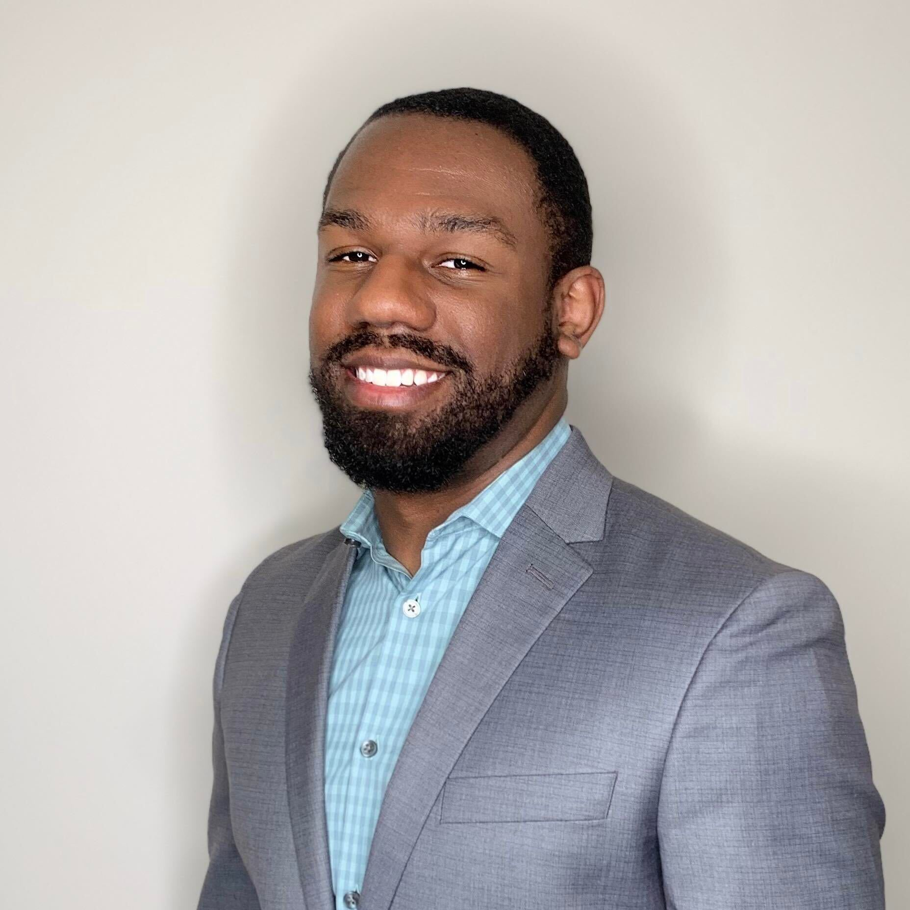
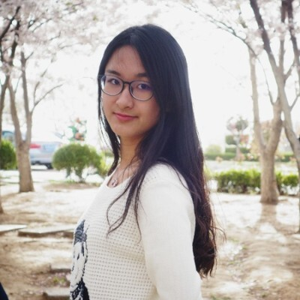
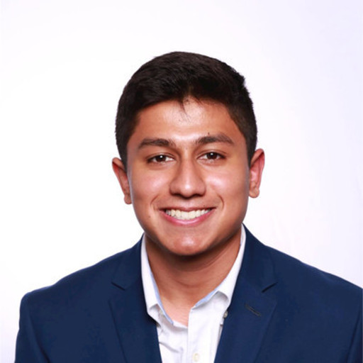
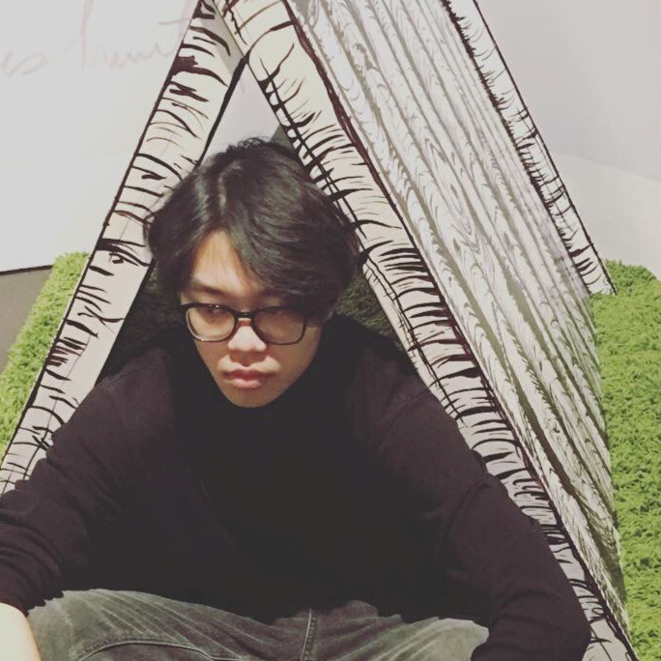
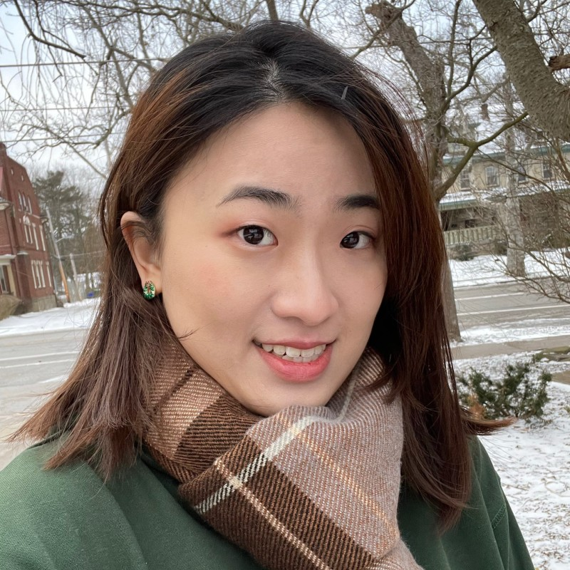
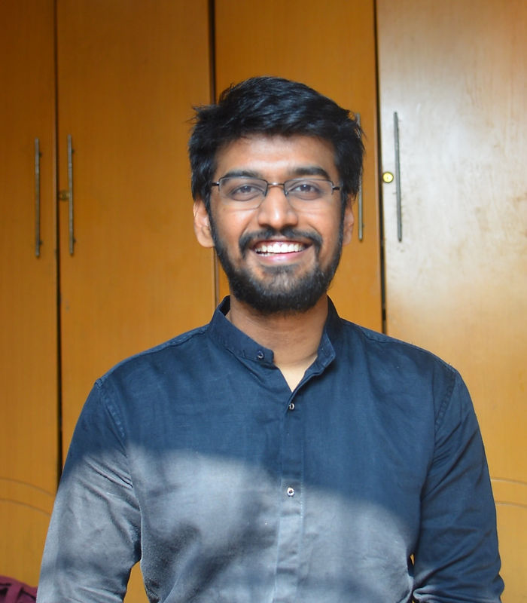
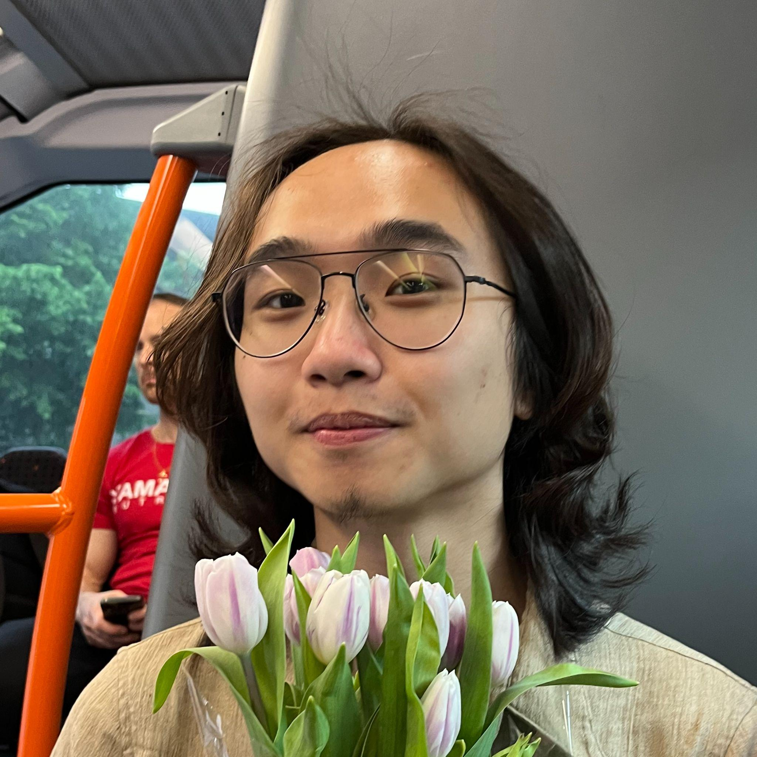
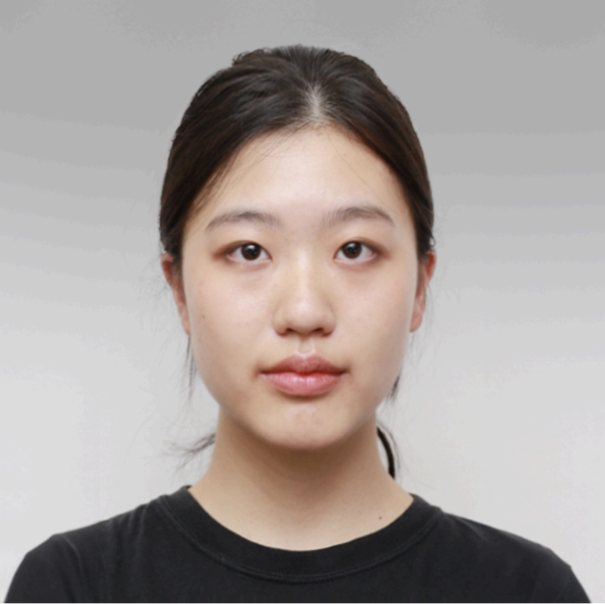
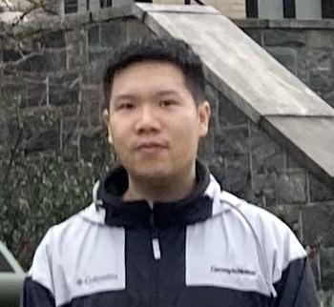
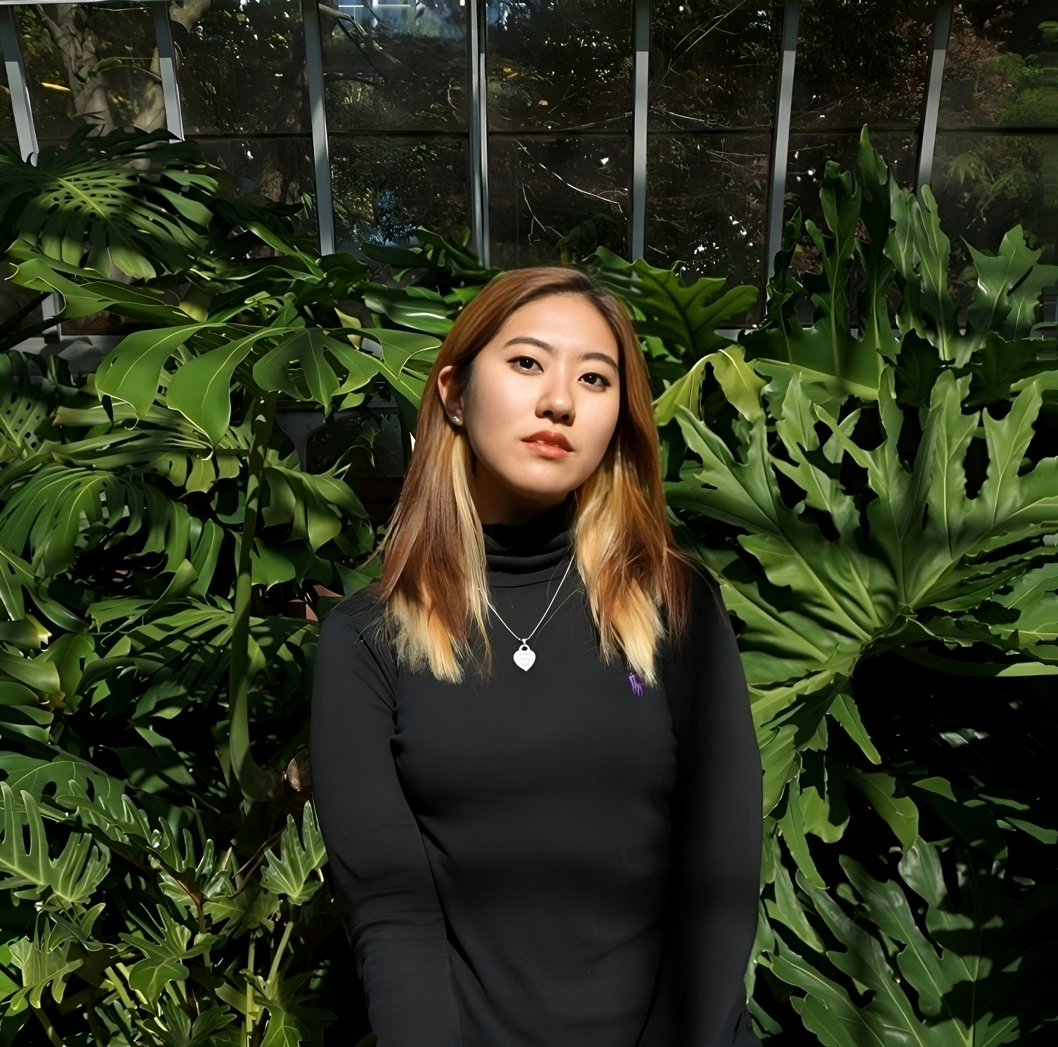
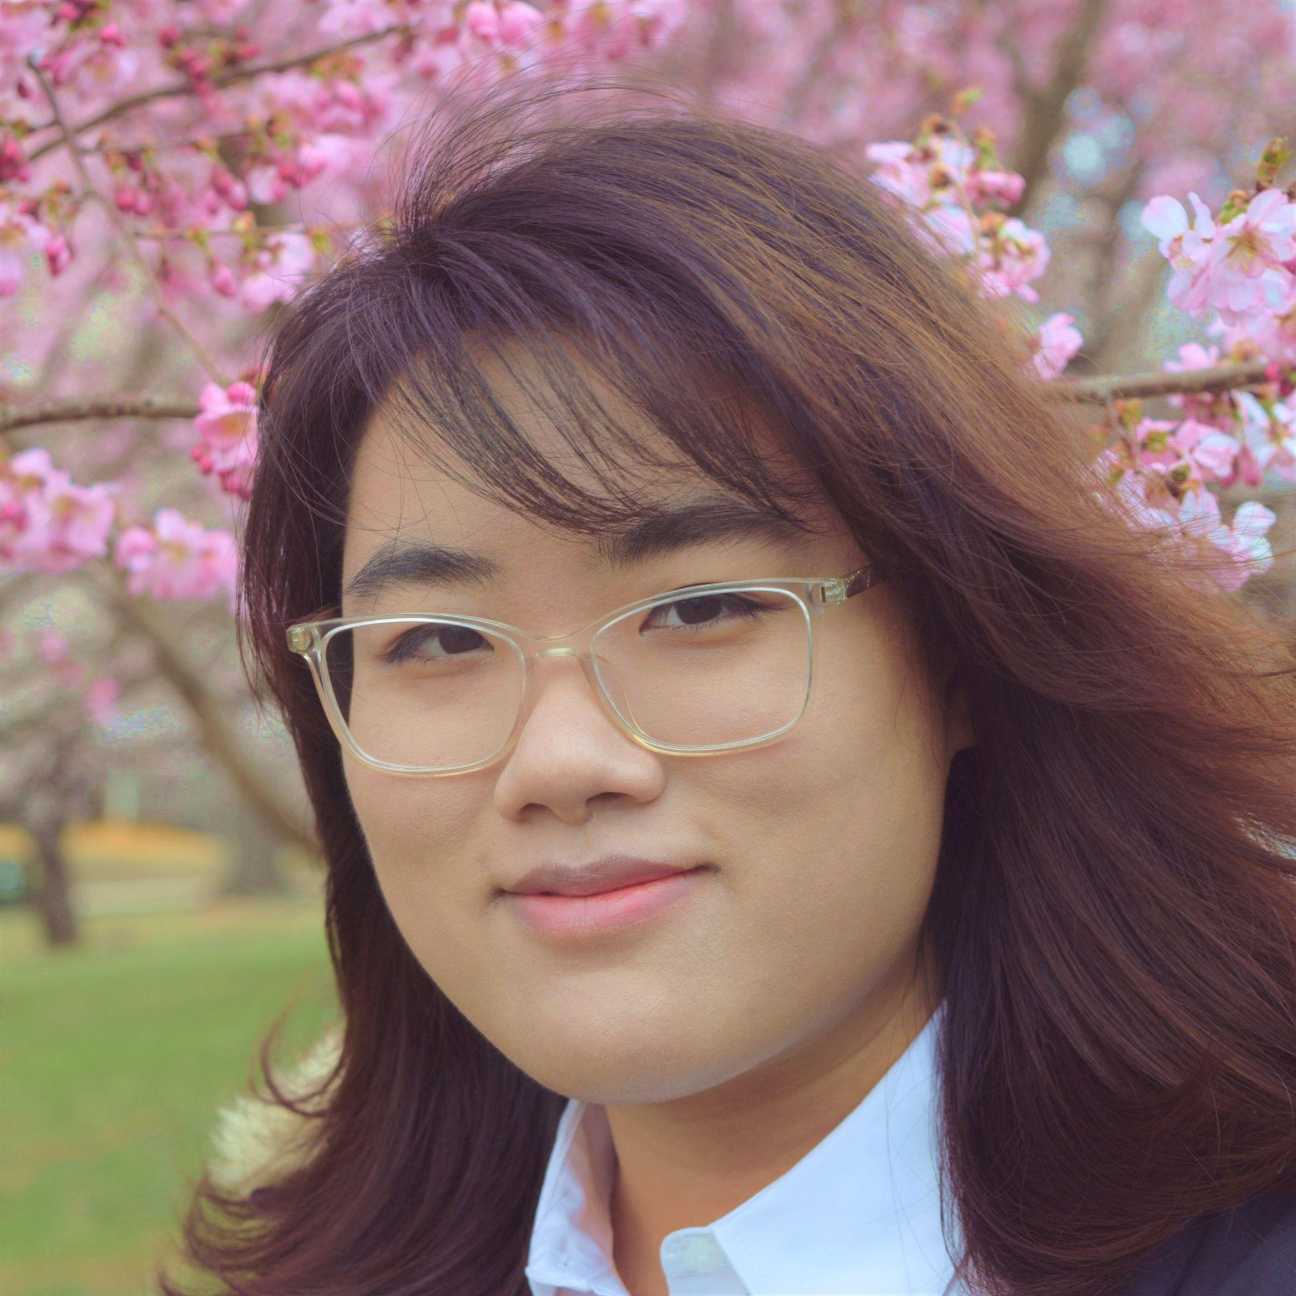
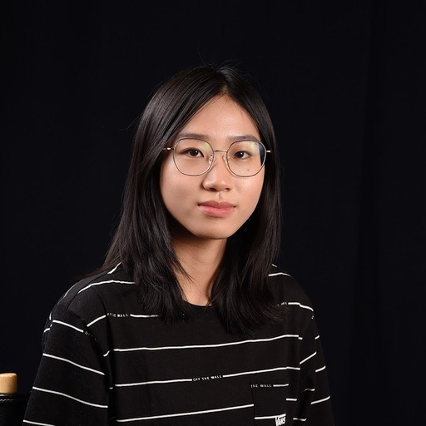
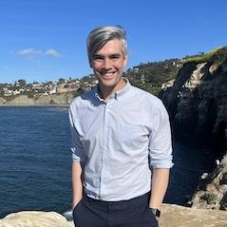
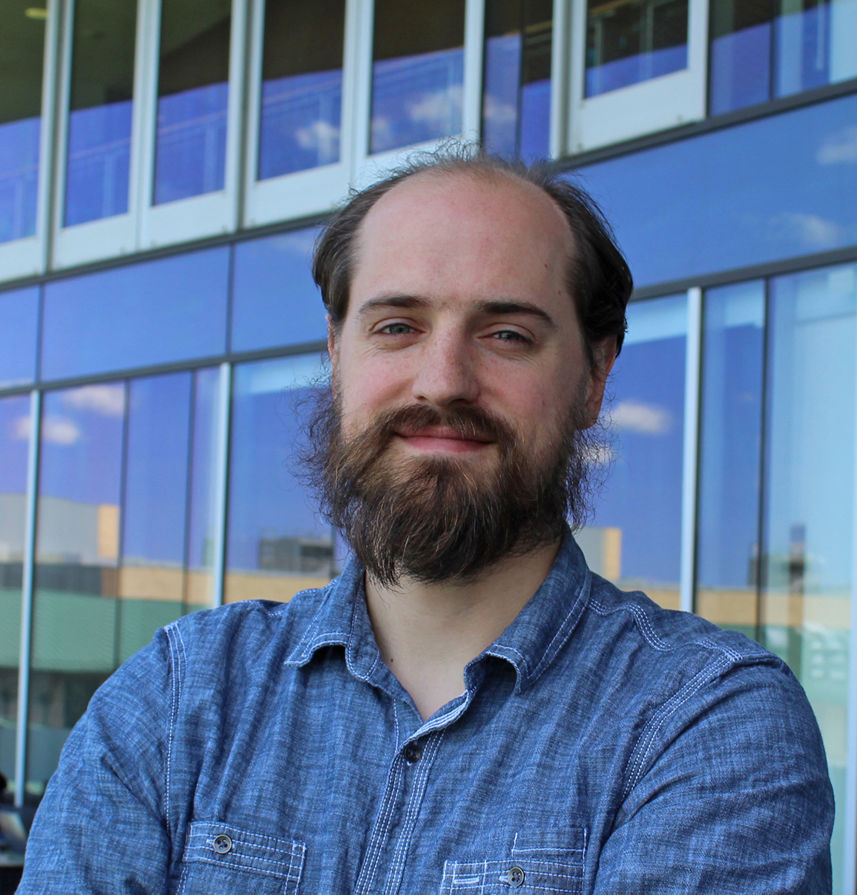
The Team
Glen Smith, Qiao Zhang, Dr. Christopher MacLellan | Georgia Tech
Adit Gupta | Drexel University
Stacey Cho, Jack Dong, Jingyuan Fang, Varun Girdhar, Yutao Huang, Marie Leung, Ziyu Li, Phoebe Wang, Kelly Zheng
Dr. Erik Harpstead | Carnegie Mellon University

Slide 15
Thank you!

